Slide 1
OPERATING SYSTEMS
DEADLOCKS
Prof. Prachi Shah
1

Slide 2
OPERATING SYSTEM
Deadlocks
What Is In This Chapter?
What is a deadlock?
Staying Safe: Preventing and Avoiding Deadlocks
Living Dangerously: Let the deadlock happen, then detect it and recover from it.
2

Slide 3
DEADLOCKS
EXAMPLES:
"It takes money to make money".
You can't get a job without experience; you can't get experience without a job.
BACKGROUND:
The cause of deadlocks: Each process needing what another process has. results from sharing resources such as memory, devices, links.
This
Under normal operation, a resource allocations proceed like this::
Request a resource (suspend until available if necessary ).
Use the resource.
Release the resource.
3

Slide 4
Bridge Crossing Example
DEADLOCKS
Traffic only in one direction.
Each section of a bridge can be viewed as a resource.
If a deadlock occurs, it can be resolved if one car backs up (preempt resources and rollback).
Several cars may have to be backed up if a deadlock occurs.
Starvation is possible.
4

Slide 5
DEADLOCK CHARACTERISATION
DEADLOCKS
NECESSARY CONDITIONS
ALL of these four must happen simultaneously for a deadlock to occur:
Mutual exclusion
One or more than one resource must be held by a process in a non-sharable (exclusive) mode.
Hold and Wait
A process holds a resource while waiting for another resource.
No Preemption
There is only voluntary release of a resource - nobody else can make a process give up a resource.
Circular Wait
Process A waits for Process B waits for Process C .... waits for Process A.
5

Slide 6
RESOURCE ALLOCATION GRAPH
DEADLOCKS
A visual ( mathematical ) way to determine if a deadlock has, or may occur.
G = ( V, E ) The graph contains nodes and edges.
V Nodes consist of processes = { P1, P2, P3, ...} and resource types
{ R1, R2, ...}
E Edges are ( Pi, Rj ) or ( Ri, Pj )
An arrow from the process to resource indicates the process is requesting the resource. An arrow from resource to process shows an instance of the resource has been allocated to the process.
Process is a circle, resource type is square; dots represent number of instances of resource in type. Request points to square, assignment comes from dot.
P_{i}
P_{i}
P
i
R
R
6
j
j

Slide 7
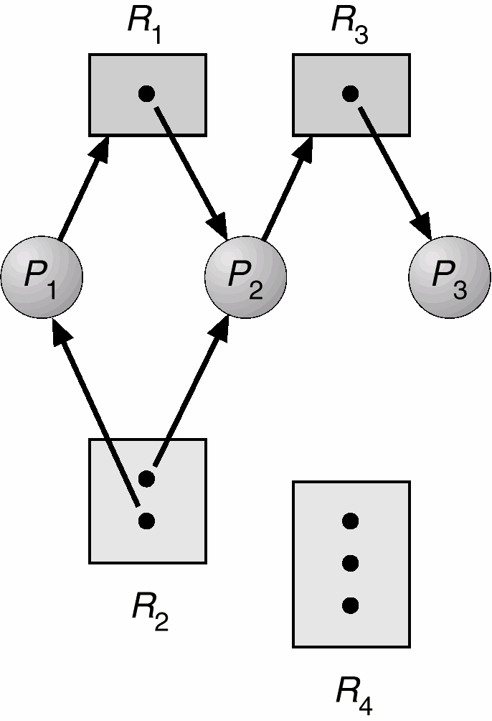
RESOURCE ALLOCATION GRAPH
DEADLOCKS
If the graph contains no cycles, then no process is deadlocked.
If there is a cycle, then:
If resource types have multiple instances, then deadlock MAY exist.
If each resource type has 1 instance, then deadlock has occurred.
R3 Assigned to P3
Resource allocation graph
P2 Requests P3

Slide 8
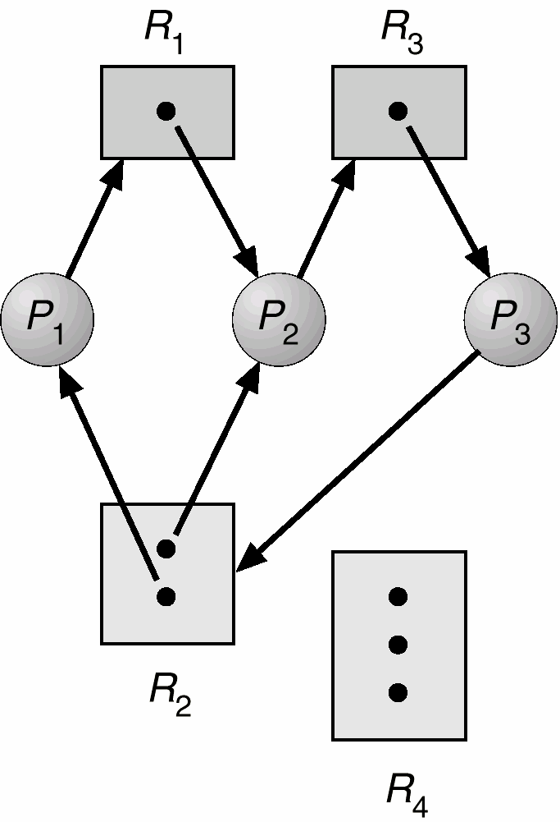
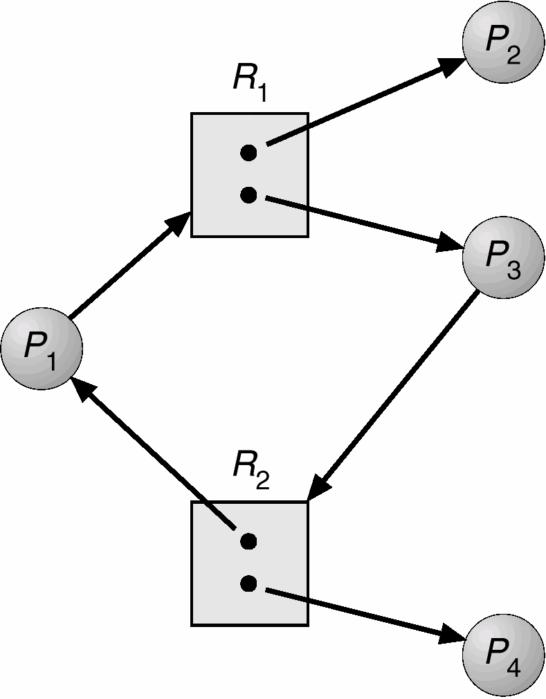
RESOURCE ALLOCATION GRAPH
DEADLOCKS
Resource allocation graph with a cycle but no deadlock.
Resource allocation graph with a deadlock.

Slide 9
Strategy
DEADLOCKS
HOW TO HANDLE DEADLOCKS – GENERAL STRATEGIES
There are three methods:
Ignore Deadlocks:
Most Operating systems do this!!
Ensure deadlock never occurs using either
Prevention Prevent any one of the 4 conditions from happening.
Avoidance Allow all deadlock conditions, but calculate cycles about to happen and stop dangerous operations..
Allow deadlock to happen. This requires using both:
Detection Know a deadlock has occurred.
Recovery Regain the resources.

Slide 10
Deadlock Prevention
DEADLOCKS
Do not allow one of the four conditions to occur.
Mutual exclusion:
Automatically holds for printers and other non-sharables.
Shared entities (read only files) don't need mutual exclusion (and aren’t susceptible to deadlock.)
Prevention not possible, since some devices are intrinsically non-sharable.
Hold and wait:
Collect all resources before execution.
A particular resource can only be requested when no others are being held. A sequence of resources is always collected beginning with the same one.
Utilization is low, starvation possible.

Slide 11
Deadlock Prevention
DEADLOCKS
Do not allow one of the four conditions to occur.
No preemption:
Release any resource already being held if the process can't get an additional resource.
Allow preemption - if a needed resource is held by another process, which is also waiting on some resource, steal it. Otherwise wait.
Circular wait:
Number resources and only request in ascending order.
EACH of these prevention techniques may cause a decrease in utilization and/or resources. For this reason, prevention isn't necessarily the best technique.
Prevention is generally the easiest to implement.

Slide 12
Deadlock Avoidance
DEADLOCKS
If we have prior knowledge of how resources will be requested, it's possible to determine if we are entering an "unsafe" state.
Possible states are:
Deadlock
No forward progress can be made.
Unsafe state
A state that may allow deadlock.
Safe state
A state is safe if a sequence of processes exist such that there are enough resources for the first to finish, and as each finishes and releases its resources there are enough for the next to finish.
The rule is simple: If a request allocation would cause an unsafe state, do not honor that request.
NOTE: All deadlocks are unsafe, but all unsafes are NOT deadlocks.

Slide 13
Deadlock Avoidance
DEADLOCKS
NOTE: All deadlocks are unsafe, but all unsafes are NOT deadlocks.
SAFE
UNSAFE
DEADLOCK
Only with luck will processes avoid deadlock.
O.S. can avoid deadlock.

Slide 14
Deadlock Avoidance
DEADLOCKS
Let's assume a very simple model: each process declares its maximum needs. In this case, algorithms exist that will ensure that no unsafe state is
reached.
There are multiple instances of the resource in these examples.
EXAMPLE:
There exists a total of 12 tape drives. The current state looks like this:
Process | Max Needs | Allocated | Current Needs
P0 | 10 | 5 | 5
P1 | 4 | 2 | 2
P2 | 9 | 2 | 7
In this example, < p1, p0, p2 > is a workable sequence.
Suppose p2 requests and is given one more tape drive. What happens then?

Slide 15
Deadlock Avoidance
DEADLOCKS
Safety Algorithm
A method used to determine if a particular state is safe. It's safe if there exists a sequence of processes such that for all the processes, there’s a way to avoid deadlock:
The algorithm uses these variables:
Need[I] – the remaining resource needs of each process.
Work - Temporary variable – how many of the resource are currently available.
Finish[I] – flag for each process showing we’ve analyzed that process or not.
need <= available + allocated[0] + .. + allocated[I-1] <- Sign of success
Let work and finish be vectors of length m and n respectively.

Slide 16
DEADLOCKS
Deadlock Avoidance
Safety Algorithm
1.
Initialize work = available
Initialize finish[i] = false, for i = 1,2,3,..n
2.
Find an i such that:
finish[i] == false and need[i] <= work
If no such i exists, go to step 4.
3.
work finish[i] goto step 2
= work + allocation[i]
= true
4.
if finish[i]
== true for all i,
then the system is in a safe state.

Slide 17





































DEADLOCKS
Deadlock Avoidance
Safety Algorithm
Do these examples:
Consider a system with: five processes, P0 to P4, three resource types, A, B, C. Type A has 10 instances, B has 5 instances, C has 7 instances.
At time T0 the following snapshot of the system is taken.
Current Needs = Requested - Allocated
 |  | 🡪 | Alloc | 🡪 |  | 🡪 | Req | 🡪 |  | 🡪 | Avail | 🡪
 |  | A | B | C |  | A | B | C |  | A | B | C
P0 |  | 0 | 1 | 0 |  | 7 | 4 | 3 |  | 3 | 3 | 2
P1 |  | 2 | 0 | 0 |  | 0 | 2 | 0
P2 |  | 3 | 0 | 2 |  | 6 | 0 | 0
P3 |  | 2 | 1 | 1 |  | 0 | 1 | 1
P4 |  | 0 | 0 | 2 |  | 4 | 3 | 1
Is the system in a safe state?

Slide 18





DEADLOCKS
Deadlock Avoidance
Safety Algorithm
Do these examples:
Now try it again with only a slight change in the request by P1.
P1 requests one additional resource of type A, and two more of type C. Request1 = (1,0,2).
Is Request1 < available?
 |  | 🡪 | Alloc | 🡪 |  | 🡪 | Req | 🡪 |  | 🡪 | Avail | 🡪
 |  | A | B | C |  | A | B | C |  | A | B | C
P0 |  | 0 | 1 | 0 |  | 7 | 4 | 3 |  | 1# | 3 | 0#
P1 |  | 3# | 0 | 2# |  | 0 | 2 | 0
P2 |  | 3 | 0 | 2 |  | 6 | 0 | 0
P3 |  | 2 | 1 | 1 |  | 0 | 1 | 1
P4 |  | 0 | 0 | 2 |  | 4 | 3 | 1
Produce the state chart as if the request is Granted and see if it’s safe. (We’ve drawn the chart as if it’s granted.
Can the request be granted?

Slide 19
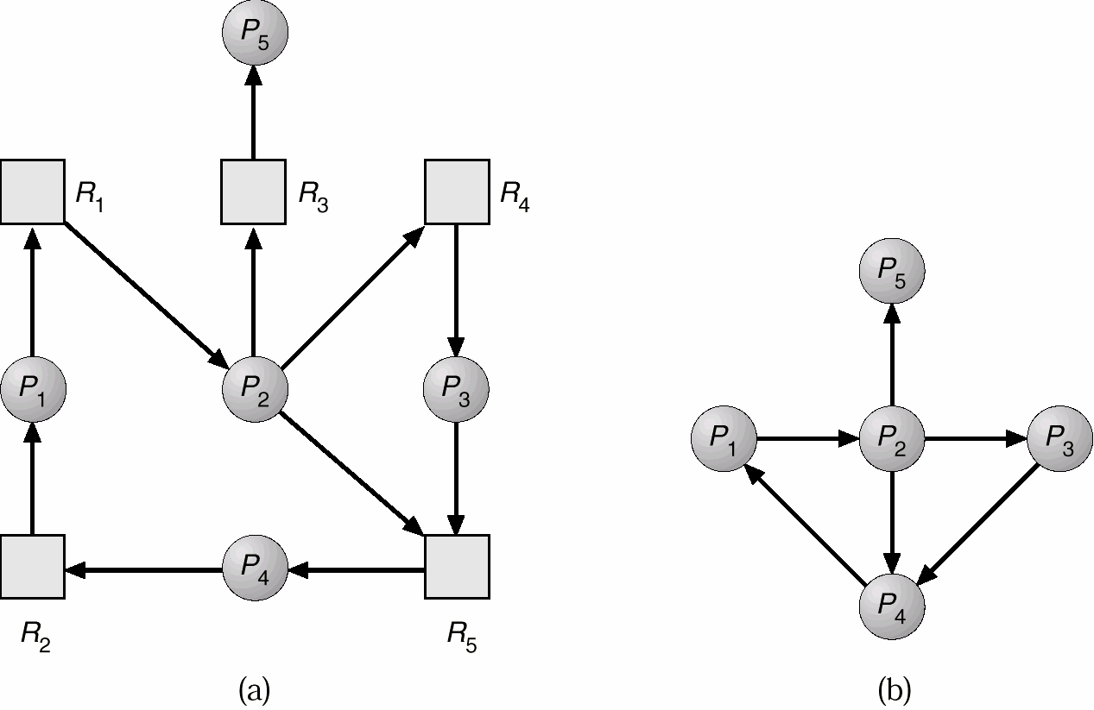
Deadlock Detection
DEADLOCKS
Need an algorithm that determines if deadlock occurred.
SINGLE INSTANCE OF A RESOURCE TYPE
Wait-for graph == remove the resources from the usual graph and collapse edges.
An edge from p(j) to p(i) implies that p(j) is waiting for p(i) to release.
Also need a means of recovering from that deadlock.

Slide 20
Deadlock Detection
DEADLOCKS
SEVERAL INSTANCES OF A RESOURCE TYPE
Complexity is of order m * n * n. We need to keep track of:
available allocation request
Let work and
records how many resources of each type are available.
number of resources of type m allocated to process n.
- number of resources of type m requested by process n.
finish be vectors of length m and n respectively.

Slide 21
Deadlock Detection
DEADLOCKS
1. Initialize
work[] = available[]
For i = 1,2,...n, if allocation[i] != 0
then
finish[i] = false; otherwise, finish[i] = true;
Find an i such that:
finish[i] == false and request[i] <= work
If no such i exists, go to step 4.
work = work + allocation[i] finish[i] = true
goto step 2
if finish[i] == false for some i, then the system is in deadlock state. IF finish[i] == false, then process p[i] is deadlocked.

Slide 22
Deadlock Detection
DEADLOCKS
EXAMPLE
We have three resources, A, B, and C. A has 7 instances, B has 2 instances, and C has 6 instances. At this time, the allocation, etc. looks like this:
Is there a sequence that will allow deadlock to be avoided?
Is there more than one sequence that will work?
 |  | 🡪 | Alloc | 🡪 |  | 🡪 | Req | 🡪 |  | 🡪 | Avail | 🡪
 |  | A | B | C |  | A | B | C |  | A | B | C
P0 |  | 0 | 1 | 0 |  | 0 | 0 | 0 |  | 0 | 0 | 0
P1 |  | 2 | 0 | 0 |  | 2 | 0 | 2
P2 |  | 3 | 0 | 3 |  | 0 | 0 | 0
P3 |  | 2 | 1 | 1 |  | 1 | 0 | 0
P4 |  | 0 | 0 | 2 |  | 0 | 0 | 2

Slide 23

Deadlock Detection
DEADLOCKS
EXAMPLE
Suppose the Request matrix is changed like this. In other words, the maximum amounts to be allocated are initially declared so that this request matrix results.
Is there now a sequence that will allow deadlock to be avoided?
USAGE OF THIS DETECTION ALGORITHM
Frequency of check depends on how often a deadlock occurs and how many processes will be affected.
 |  | 🡪 | Alloc | 🡪 |  | 🡪 | Req | 🡪 |  | 🡪 | Avail | 🡪
 |  | A | B | C |  | A | B | C |  | A | B | C
P0 |  | 0 | 1 | 0 |  | 0 | 0 | 0 |  | 0 | 0 | 0
P1 |  | 2 | 0 | 0 |  | 2 | 0 | 2
P2 |  | 3 | 0 | 3 |  | 0 | 0 | 1#
P3 |  | 2 | 1 | 1 |  | 1 | 0 | 0
P4 |  | 0 | 0 | 2 |  | 0 | 0 | 2

Slide 24
Deadlock Recovery
DEADLOCKS
So, the deadlock has occurred. Now, how do we get the resources back and gain forward progress?
PROCESS TERMINATION:
Could delete all the processes in the deadlock -- this is expensive.
Delete one at a time until deadlock is broken ( time consuming ).
Select who to terminate based on priority, time executed, time to completion, needs for completion, or depth of rollback
In general, it's easier to preempt the resource, than to terminate the process.
RESOURCE PREEMPTION:
Select a victim - which process and which resource to preempt.
Rollback to previously defined "safe" state.
Prevent one process from always being the one preempted ( starvation ).

Slide 25
Deadlock Recovery
DEADLOCKS
COMBINED APPROACH TO DEADLOCK HANDLING:
Type of resource may dictate best deadlock handling. Look at ease of implementation, and effect on performance.
In other words, there is no one best technique.
Cases include:
Preemption for memory, Preallocation for swap space,
Avoidance for devices ( can extract Needs from process. )

Slide 26
DEADLOCKS
WRAPUP
In this section we have:
Looked at necessary conditions for a deadlock to occur.
Determined how to prevent, avoid, detect and recover from deadlocks.

